Slide 1
Propositional Logic

Slide 2
Propositional logic
Logical constants: true, false
Propositional symbols: P, Q, S, ... (atomic sentences)
Wrapping parentheses: ( … )
Sentences are combined by connectives:
  ∧ ...and [conjunction]
  ∨ ...or [disjunction]
  ⇒...implies [implication / conditional]
  ⇔..is equivalent [biconditional]
  ¬ ...not [negation]
Literal: atomic sentence or negated atomic sentence

Slide 3
Examples of PL sentences
P means “It is hot.”
Q means “It is humid.”
R means “It is raining.”
(P ∧ Q) → R
  “If it is hot and humid, then it is raining”
Q → P
  “If it is humid, then it is hot”
A better way:
  Hot = “It is hot”
  Humid = “It is humid”
  Raining = “It is raining”

Slide 4
Propositional logic (PL)
A simple language useful for showing key ideas and definitions
User defines a set of propositional symbols, like P and Q.
User defines the semantics of each propositional symbol:
  P means “It is hot”
  Q means “It is humid”
  R means “It is raining”
A sentence (well formed formula) is defined as follows:
  A symbol is a sentence
  If S is a sentence, then ¬S is a sentence
  If S is a sentence, then (S) is a sentence
  If S and T are sentences, then (S ∨ T), (S ∧ T), (S → T), and (S ↔ T) are sentences
  A sentence results from a finite number of applications of the above rules

Slide 5
A BNF grammar of sentences in propositional logic
S := <Sentence> ;
<Sentence> := <AtomicSentence> | <ComplexSentence> ;
<AtomicSentence> := "TRUE" | "FALSE" |
"P" | "Q" | "S" ;
<ComplexSentence> := "(" <Sentence> ")" |
<Sentence> <Connective> <Sentence> |
"NOT" <Sentence> ;
<Connective> := "NOT" | "AND" | "OR" | "IMPLIES" | "EQUIVALENT" ;

Slide 6
Some terms
The meaning or semantics of a sentence determines its interpretation.
Given the truth values of all symbols in a sentence, it can be “evaluated” to determine its truth value (True or False).
A model for a KB is a “possible world” (assignment of truth values to propositional symbols) in which each sentence in the KB is True.

Slide 7
More terms
A valid sentence or tautology is a sentence that is True under all interpretations, no matter what the world is actually like or how the semantics are defined. Example: “It’s raining or it’s not raining.”
An inconsistent sentence or contradiction is a sentence that is False under all interpretations. The world is never like what it describes, as in “It’s raining and it’s not raining.”
P entails Q, written P |= Q, means that whenever P is True, so is Q. In other words, all models of P are also models of Q.

Slide 8
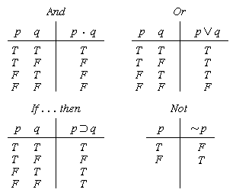
Truth tables

Slide 9


Truth tables II
The five logical connectives:
A complex sentence:

Slide 10
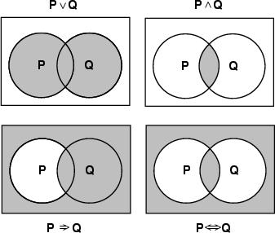
Models of complex sentences

Slide 11
Inference rules
Logical inference is used to create new sentences that logically follow from a given set of predicate calculus sentences (KB).
An inference rule is sound if every sentence X produced by an inference rule operating on a KB logically follows from the KB. (That is, the inference rule does not create any contradictions)
An inference rule is complete if it is able to produce every expression that logically follows from (is entailed by) the KB. (Note the analogy to complete search algorithms.)

Slide 12
Sound rules of inference
Here are some examples of sound rules of inference
  A rule is sound if its conclusion is true whenever the premise is true
Each can be shown to be sound using a truth table
  RULE PREMISE CONCLUSION
  Modus Ponens A, A → B B
  And Introduction A, B A ∧ B
  And Elimination A ∧ B A
  Double Negation ¬¬A A
  Unit Resolution A ∨ B, ¬B A
  Resolution A ∨ B, ¬B ∨ C A ∨ C

Slide 13
Soundness of modus ponens
A | B | A → B | OK?
True | True | True | √
True | False | False | √
False | True | True | √
False | False | True | √

Slide 14
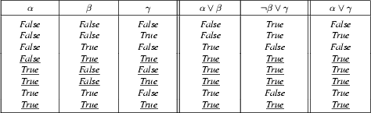
Soundness of the resolution inference rule

Slide 15
Proving things
A proof is a sequence of sentences, where each sentence is either a premise or a sentence derived from earlier sentences in the proof by one of the rules of inference.
The last sentence is the theorem (also called goal or query) that we want to prove.
Example for the “weather problem” given above.
  1 Humid Premise “It is humid”
  2 Humid→Hot Premise “If it is humid, it is hot”
  3 Hot Modus Ponens(1,2) “It is hot”
  4 (Hot∧Humid)→Rain Premise “If it’s hot & humid, it’s raining”
  5 Hot∧Humid And Introduction(1,2) “It is hot and humid”
  6 Rain Modus Ponens(4,5) “It is raining”

Slide 16
Horn sentences
A Horn sentence or Horn clause has the form:
  P1 ∧ P2 ∧ P3 ... ∧ Pn → Q
or alternatively
  ¬P1 ∨ ¬ P2 ∨ ¬ P3 ... ∨ ¬ Pn ∨ Q
where Ps and Q are non-negated atoms
To get a proof for Horn sentences, apply Modus Ponens repeatedly until nothing can be done
We will use the Horn clause form later
(P → Q) = (¬P ∨ Q)

Slide 17
Entailment and derivation
Entailment: KB |= Q
  Q is entailed by KB (a set of premises or assumptions) if and only if there is no logically possible world in which Q is false while all the premises in KB are true.
  Or, stated positively, Q is entailed by KB if and only if the conclusion is true in every logically possible world in which all the premises in KB are true.
Derivation: KB |- Q
  We can derive Q from KB if there is a proof consisting of a sequence of valid inference steps starting from the premises in KB and resulting in Q

Slide 18
Two important properties for inference
Soundness: If KB |- Q then KB |= Q
  If Q is derived from a set of sentences KB using a given set of rules of inference, then Q is entailed by KB.
  Hence, inference produces only real entailments, or any sentence that follows deductively from the premises is valid.
Completeness: If KB |= Q then KB |- Q
  If Q is entailed by a set of sentences KB, then Q can be derived from KB using the rules of inference.
  Hence, inference produces all entailments, or all valid sentences can be proved from the premises.

Slide 19
Propositional logic is a weak language
Hard to identify “individuals” (e.g., Mary, 3)
Can’t directly talk about properties of individuals or relations between individuals (e.g., “Bill is tall”)
Generalizations, patterns, regularities can’t easily be represented (e.g., “all triangles have 3 sides”)
First-Order Logic (abbreviated FOL or FOPC) is expressive enough to concisely represent this kind of information
  FOL adds relations, variables, and quantifiers, e.g.,
    “Every elephant is gray”: ∀ x (elephant(x) → gray(x))
    “There is a white alligator”: ∃ x (alligator(X) ^ white(X))

Slide 20
Example
Consider the problem of representing the following information:
  Every person is mortal.
  Confucius is a person.
  Confucius is mortal.
How can these sentences be represented so that we can infer the third sentence from the first two?

Slide 21
Example II
In PL we have to create propositional symbols to stand for all or part of each sentence. For example, we might have:
  P = “person”; Q = “mortal”; R = “Confucius”
so the above 3 sentences are represented as:
  P → Q; R → P; R → Q
Although the third sentence is entailed by the first two, we needed an explicit symbol, R, to represent an individual, Confucius, who is a member of the classes “person” and “mortal”
To represent other individuals we must introduce separate symbols for each one, with some way to represent the fact that all individuals who are “people” are also “mortal”

Slide 22
The “Hunt the Wumpus” agent
Some atomic propositions:
  S12 = There is a stench in cell (1,2)
  B34 = There is a breeze in cell (3,4)
  W22 = The Wumpus is in cell (2,2)
  V11 = We have visited cell (1,1)
  OK11 = Cell (1,1) is safe.
  etc
Some rules:
  (R1) ¬S11 → ¬W11 ∧ ¬ W12 ∧ ¬ W21
  (R2) ¬ S21 → ¬W11 ∧ ¬ W21 ∧ ¬ W22 ∧ ¬ W31
  (R3) ¬ S12 → ¬W11 ∧ ¬ W12 ∧ ¬ W22 ∧ ¬ W13
  (R4) S12 → W13 ∨ W12 ∨ W22 ∨ W11
  etc
Note that the lack of variables requires us to give similar rules for each cell

Slide 23
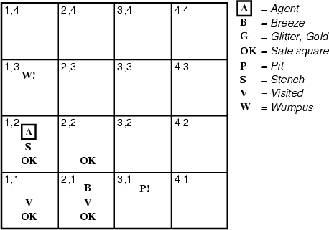
After the third move
We can prove that the Wumpus is in (1,3) using the four rules given.
See R&N section 7.5

Slide 24
Proving W13
Apply MP with ¬S11 and R1:
  ¬ W11 ∧ ¬ W12 ∧ ¬ W21
Apply And-Elimination to this, yielding 3 sentences:
  ¬ W11, ¬ W12, ¬ W21
Apply MP to ~S21 and R2, then apply And-elimination:
  ¬ W22, ¬ W21, ¬ W31
Apply MP to S12 and R4 to obtain:
  W13 ∨ W12 ∨ W22 ∨ W11
Apply Unit resolution on (W13 ∨ W12 ∨ W22 ∨ W11) and ¬W11:
  W13 ∨ W12 ∨ W22
Apply Unit Resolution with (W13 ∨ W12 ∨ W22) and ¬W22:
  W13 ∨ W12
Apply UR with (W13 ∨ W12) and ¬W12:
  W13
QED

Slide 25
Problems with the propositional Wumpus hunter
Lack of variables prevents stating more general rules
  We need a set of similar rules for each cell
Change of the KB over time is difficult to represent
  Standard technique is to index facts with the time when they’re true
  This means we have a separate KB for every time point

Slide 26
Summary
The process of deriving new sentences from old one is called inference.
  Sound inference processes derives true conclusions given true premises
  Complete inference processes derive all true conclusions from a set of premises
A valid sentence is true in all worlds under all interpretations
If an implication sentence can be shown to be valid, then—given its premise—its consequent can be derived
Different logics make different commitments about what the world is made of and what kind of beliefs we can have regarding the facts
  Logics are useful for the commitments they do not make because lack of commitment gives the knowledge base engineer more freedom
Propositional logic commits only to the existence of facts that may or may not be the case in the world being represented
  It has a simple syntax and simple semantics. It suffices to illustrate the process of inference
  Propositional logic quickly becomes impractical, even for very small worlds

